Slide 1
Alcohol related LivER disease audiT : ALERT-UK
A national audit of provision of inpatient care for patients with ArLD in the UK.
2024
alertaudituk@gmail.com

Slide 2
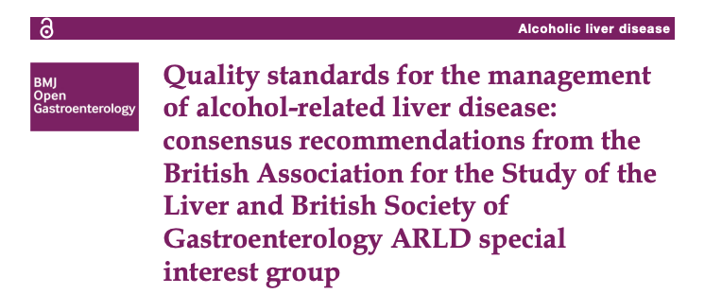
Background
Significant shortcomings in the quality of inpatient care
.
Allison M et al Deaths from alcohol-related liver disease in the UK: an escalating tragedy. Lancet. 2023;401(10375):418-20
NCEPOD. Remeasuring the Units An update on the organization of alcohol-related liver disease services. 2022
Parker R, Allison M, Anderson S, Aspinall R, Bardell S, Bains V, et al. Quality standards for the management of alcohol-related liver disease: BMJ Open Gastroenterol. 2023;10(1)

Slide 3
Aims
Evaluate current service provision for inpatients with ARLD in the UK against defined quality standards
Identify areas of care for targeted improvement
Secondary objectives:
To identify any patient-related factors or institution-related factors associated with provision of inpatient ARLD care and outcomes

Slide 4
Site Eligibility
All UK acute hospitals caring for inpatients with ArLD
Site recruitment via :
  BSG and BASL website link
  Hepatology and alcohol nursing networks
  National and local trainee networks
  Social media
Site data collection team:
  Designated site lead
  Up to 4 further team members ( e.g. alcohol team, specialist nurses, trainees)

Slide 5
Patient Identification
Inclusion criteria
  First 20 patients in study period
  Reach end of admission episode (discharge/transfer/death) between 1st July 2022 – 30th September 2022 (inclusive)
  ARLD as a Primary or Secondary diagnosis
Exclusion criteria
  Patients under 18 years of age
  Patients on EOLC pathway prior to or within 24 hours of admission
  Patients transferred from another centre for specialist service/ procedure
  Active non-hepatic malignancy or metastatic liver cancer

Slide 6

Patient Identification
Identification
  Pre coded spreadsheet to apply Liverpool Alcohol related liver disease Algorithm (LAA) :
1. ARLD-specific code recorded as primary diagnosis (ARLD-primary)
2. ARLD-specific code recorded as secondary diagnosis. All higher order diagnoses must be either: A) Symptom, sign or complication (jaundice, varices, acute kidney injury, encephalopathy and other relevant diagnoses suggesting admission for ARLD complications), Or B) Other alcohol-specific diagnosis (codes for other alcohol specific disorders such as alcohol intoxication, withdrawal, and organ-specific disorders, e.g. alcoholic gastritis)
3. Nonspecific liver disease recorded as a primary diagnosis (codes for liver disease without specific aetiology, e.g. cirrhosis unspecified) All lower order diagnoses must be either: A) Symptom, sign or complication, Or B) Other alcohol-specific diagnosis (at least one must be recorded)
4. Nonspecific liver disease recorded as a secondary diagnosis All higher order diagnoses must be either: A) Symptom, sign or complication, Or B) Other alcohol-specific diagnosis (at least one must be recorded)
Dhanda A et al. The Liverpool alcohol-related liver disease algorithm identifies twice as many emergency admissions compared to standard methods when applied to Hospital Episode Statistics for England. Aliment Pharmacol Ther. 2023;57(4):368-77.

Slide 7
Methods : Data Collection
Site level data at registration
Anonymised individual level data extracted from EHR or paper notes :
  Demographic data
  Assessment of AUD management - withdrawal management, involvement of designated alcohol care team , use of relapse prevention medication
  Discharge planning and follow up
  Disease severity variables
  Outcomes at 1 year : including clinic attendance, consideration for transplant suitability and palliative care involvement
Notes:
Anoymised indivisual level variables that will encompass all of the derined quality stabdards but also deograohic data, diseae severity markers , assessment of follow up provision and outcomes at 1 year post admission

Slide 8



Dissemination
Published under collective group name ’ALERT UK’
All contributors will be recognised as formal collaborators
Steering group
Name | Affiliation | Role on committee
Ashwin Dhanda | University of Plymouth | Lead
Laura Burke | Leeds Teaching Hospitals | Trainee Co-Lead
Vikram Bains | Cambridge University Hospitals | Trainee Co-Lead
Dianne Backhouse | Hull University Teaching Hospitals | Nurse Lead
Ewan Forrest | Greater Glasgow and Clyde | Scotland Co-Lead
Mhairi Donnelly | Royal Infirmary of Edinburgh | Scotland Co-Lead
Keith Bodger | University of Liverpool | LAA tool implementation
Conor Braniff | Belfast Trust | NI Co-Lead
Roger McCorry | Belfast Trust | NI Co-Lead
Arj Singanayagam | St George’s Hospital | London/South of England Lead
Andrew Yeoman | Aneurin Bevan | Wales Lead
Richard Parker | Leeds Teaching Hospitals | North of England Lead

Slide 9

To register:
1. Follow QR code or link to register your hospital( 1 per site)
2. On receipt of your registration form, the local audit lead will be sent a pre coded spreadsheet with instructions to send to your local data team. This will identify your list of 20 patients for inclusion with an ‘end of admission’ date during the period 1st July 2022 – 30th September 2022 (inclusive). A link to the online data collection form will be sent to the audit lead (1 form per patient to be completed).
3. Please also register ALERT-UK with your local organisation's audit department. A single page project summary and the HRA decision tool outcome is available to download below to support your local registration process.
If you have any questions, please contact us at alertaudituk@gmail.com
https://forms.gle/VCgbhYT6te2BiQ5k9

