Slide 1
‘Hepatology Training: Past and Future’
Bill Griffiths
Consultant Hepatologist/Specialty Lead, Cambridge Liver Unit
Gastroenterology SAC BASL representative

Slide 2
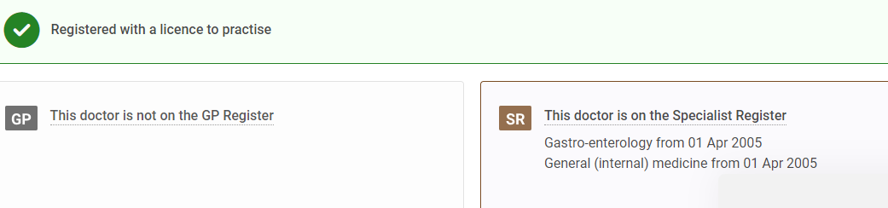
Bill Griffiths (long in the tooth)
Am I a Hepatologist?

Slide 3
Evolution of hepatology training in UK
2003-2014 local recruitment to specialist training posts (15 initially) all within or linked to transplant centre (6 m minimum).
Hepatology ATP year integrated into training (2010 curriculum) with subspecialty accreditation in Hepatology.
‘Academic’ route separate due to CL constraints.
Both require 24 m total hepatology, not more than 6 m in level 1 (DGH) centre with curriculum core/advanced hepatology.
3 m minimum in level 3 (transplant) centre from 2010.
The posts gradually all excluded GIM from that year.
Move to national recruitment to improve transparency and access to posts esp in regions without them.

Slide 4
National recruitment (2014-2023)
First intake 2014 via national short-listing/interview process for ‘ATP’ (subspecialty) recruitment.
Trainees ranked and their location preference noted - ie worked way down the list until all posts filled.
Generally around 50% trainees remained within home region.
Academic bias reduced over time to promote DGH hepatology.
Gradual post expansion from 17 to 26 over 10 years bringing this also closer to BSG/BASL stipulation of 25% of all trainees to go into hepatology.
Along the way, formal ratification of level 2 and enhanced level 1 centres for quality control and to ensure capacity in each region for core/remaining training.

Slide 5
Shape of Training
GMC enforced a reduction in specialty training for Group 1 specialties from 5 years to 4 years and removal of subspecialty accreditation.
New 2022 Gastroenterology curriculum developed with CCT in 'Gastroenterology (GIM)’.
Necessity to incorporate hepatology within this shortened curriculum ie 2 yrs gastro / 2 yrs hepatology (with 25% GIM).
JRCPTB stipulated that were no longer allowed to ‘recruit’ (nationally) - trainees have already been recruited to an NTN so this needed now to be a region based ‘allocation’ into hepatology training.
Fortunately by now all regions had posts.
3 m minimum transplant centre experience important component of hepatology training even if destined for DGH.
Full colonoscopy training would not be expected and essentially discouraged as competing with hepatology training.

Slide 6
Gastroenterology wine glass model
CCT Gastroenterology/GIM
Therapeutic
OGD
ST7 Complex Gastro/GIM
ST6 Colonoscopy
ST7 DGH Hep/GIM
ST6 Tertiary Hep = ATP year
ST5 Core hep/nutrition/endoscopy/GIM
ST4 Gastro/immersive endoscopy/GIM
IM 3

Slide 7
2024 new ‘allocation’ process
26 posts across all regions in E&W, all linked to transplant centre for minimum 3 m, NI have agreement with B’ham, Scottish regions via Edinburgh separate process.
In E&W mean 1 hep ATP post per 19 standard training posts (15 for NI and Scotland).
Hep-interested trainees completed ‘information form’ via websites / returned by Xmas to TPD and Bill Griffiths.
Option to request ATP in another region if desired (some do preference elsewhere).
Regional allocation process January/February 2024.
National ‘wash up’ to look at empty posts and see who was happy to move.
Allowance for personal circumstances where possible.

Slide 8
2024 allocation results
33 trainees (14 LTFT) registered interest for 26 posts - 25 posts filled by 27 trainees (10 LTFT), some local solutions, some to enter following year.
Good collaboration across pan London to fill their various posts. Coordination between TPDs/BG.
Trainee flexibility between linked regions re 6 m vs 3 m (Birm/Lpool – a trainee was unable to leave for 6 m so both trainees agreed 9 m/3m).
3 trainees took up posts in ‘neighbouring’ regions.
Where competition for posts, allocation was generally sorted by a ‘fairness for all approach’ (Birmingham held an interview process but this is discouraged).
A Plymouth trainee unable to fulfil commitment at Kings so a workaround was suggested - not preferable to gaining the full transplant centre experience, Plymouth one of the better placed centres given early repatriation process.

Slide 9
2025 allocation results
46 trainees applied for 27 posts
15 from London regions
2 mat leave return
15 LTFT, majority 80%
26 posts filled by 29 trainees
10 LTFT, 3 job share
ST at time of application: ST4 x 3, ST6 x 4, rest ST5
3 training in colonoscopy (all ST5)
3 trainees moving out of region
Rest - 1 deferred for mat leave, local solutions, deferral

Slide 10
2026 entry
Early decision re hepatology helpful (but if late and unable to get hepatology ATP can get experience post CCT).
Ensure TPD is aware of interest in hepatology.
Ensure ‘core’ hepatology completed before end ST5.
Aim ideally to do hepatology in ST6 but there is some flexibility.
Don’t expect to continue in colonoscopy (NB not a requirement for DGH hepatology) - some trainees will have significant nos with ST4 immersion so may be able to complete but not at an advanced level so ?how useful.
No hepatology ‘badge’ as such but it will be obvious to an appointment panel from your CV/training record if you have specialised in hepatology training.

Slide 11
2026 entry
All regions have posts but if competition within a region there will be attempts to look at job sharing, deferring an earlier trainee, moving to another region.
Qn about ‘what is fair’ eg if someone has already done a lot of hep/transplant/academic training vs DGH hepatology aspiration.
The form helps detail the commitment to specialty.
?ATP in a neighbouring or other region as may be gaps – any move to another region (whole or part post) = OOPT and you can claim for relocation/travel from the 8K pot available in parent deanery for this purpose – there are many trainees who have done this previously and have experience.
Check the BSG or BASL websites (both have all necessary details) and complete the ATP entry form (www.bsg.org.uk/training or www.basl.org.uk).
If you have any specific queries – bill.griffiths@nhs.net

Slide 12
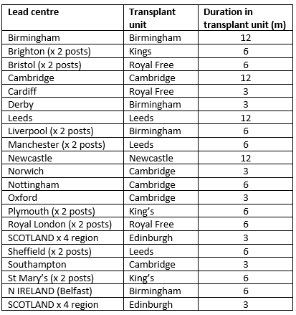
2026 posts

Slide 13
THANK YOU

