Slide 1
Hepatology pathway 2025 – information for trainees
Bill Griffiths
Consultant Hepatologist, Cambridge
Gastroenterology SAC BASL representative

Slide 2
Background for new trainees
Hepatology ATPs were nationally recruited whilst hepatology was a GMC ‘subspecialty’ – the last round of this was for September 2023 entry
HEE mandated removal of this process for the 2022 curriculum as Hepatology no longer a subspecialty – not allowed to ‘re-recruit’ having obtained gastro NTN
Agreed to maintain hepatology ATPs within the 4 year Shape training period as part of the Hepatology pathway with preferred entry at ST6
Conversion to regional appointment system required – referred to as ‘allocation’ rather than ‘recruitment’
BASL strongly recommend minimum 3 m transplant centre experience for all trainees wishing to become hepatologists even to work in DGH = invaluable for those in non transplant centre regions - trainees to date will testify to this
All non transplant centre regions (bar N Ireland) have a hepatology ATP with integrated period in a transplant centre as of 2024 entry

Slide 3
2024 ‘allocation' process
Updated information on BASL/BSG websites
26 posts across all regions in E&W, all linked to transplant centre for minimum 3 m, NI required funding, Scotland internal
Hep-interested trainees completed ‘information form’ via websites / returned before Xmas
Option to request ATP in another region if desired
Regional allocation process January/February 2024 – this involved working out the fairest solution for all trainees applying where a clear commitment to the specialty is evident
National ‘wash up’ to look at empty posts
Allowance for personal circumstances where possible

Slide 4
2024 allocation results for information
33 trainees applied for 26 posts using the approved form - 25 posts filled by 27 trainees, some local solutions, some to enter following year
Good collaboration across pan London to fill their various posts. BG was in touch with every TPD and liver lead as well as linking the TPDs between non transplant and transplant regions where required
Trainee flexibility between linked regions re 6 m vs 3 m (Birm/Lpool – a trainee was unable to leave for 6 m so both trainees agreed 9 m/3m)
3 trainees took up posts in ‘neighbouring’ regions
Where competition for posts, allocation was generally sorted by a ‘fairness for all approach’ (Birmingham held an interview process but this is discouraged)
1 trainee only in non transplant centre region said they would be unable to fulfil the period in the transplant centre due to exceptional circumstances so a work around has been agreed along lines of minimum experience required – this only works because the region involved has the strongest satellite transplant centre of any. Much more preferable from a training perspective to obtain the pre-set experience though.
14/33 applicants = LTFT (10 x 80% 6 M 4 F, 4 x 60% all F) and 10 were given posts

Slide 5
2025 entry
Early decision re hepatology helpful (but if unable to get hepatology ATP can get experience post CCT)
Ensure TPD is aware of interest in hepatology
Ensure ‘core’ hepatology completed before end ST5
Aim ideally to do hepatology in ST6 but there is some flexibility
Don’t expect to continue in colonoscopy (NB not required for DGH hepatology - flexi sig should be sufficient)
No hepatology ‘badge’ as such - same CCT for all – this is currently ‘Gastroenterology’ (as it was in my day – before hepatology was a subspecialty) as an Act of Parliament is required to convert to ‘Gastroenterology and Hepatology’. We don’t know when this change is going to occur but it will be obvious to an appointment panel from your CV/training record if you are a hepatology trainee or not.

Slide 6
2025 entry
There should be enough posts to go round but if competition within a region there will be attempts to look at job sharing, deferring an earlier trainee, moving to other region where happy to (see below). It is a difficult balance with older trainees already committed and newer trainees starting on the 2022 curriculum who we can’t disadvantage. We cannot/not allowed to use a ‘ranking’ system anymore.
Consider whether you might be able to complete an ATP in a neighbouring or other region as may be gaps – any move to another region (whole or part post) = OOPT and you can claim for relocation/travel from the 8K pot available in parent deanery for this purpose – there are many trainees who have done this previously and have experience. Please contact the BSG/BASL trainee reps who can help you with this.
Check the BSG or BASL website and complete the ATP entry form (www.bsg.org.uk/training or www.basl.org.uk)
If you have any specific queries – bill.griffiths@nhs.net

Slide 7
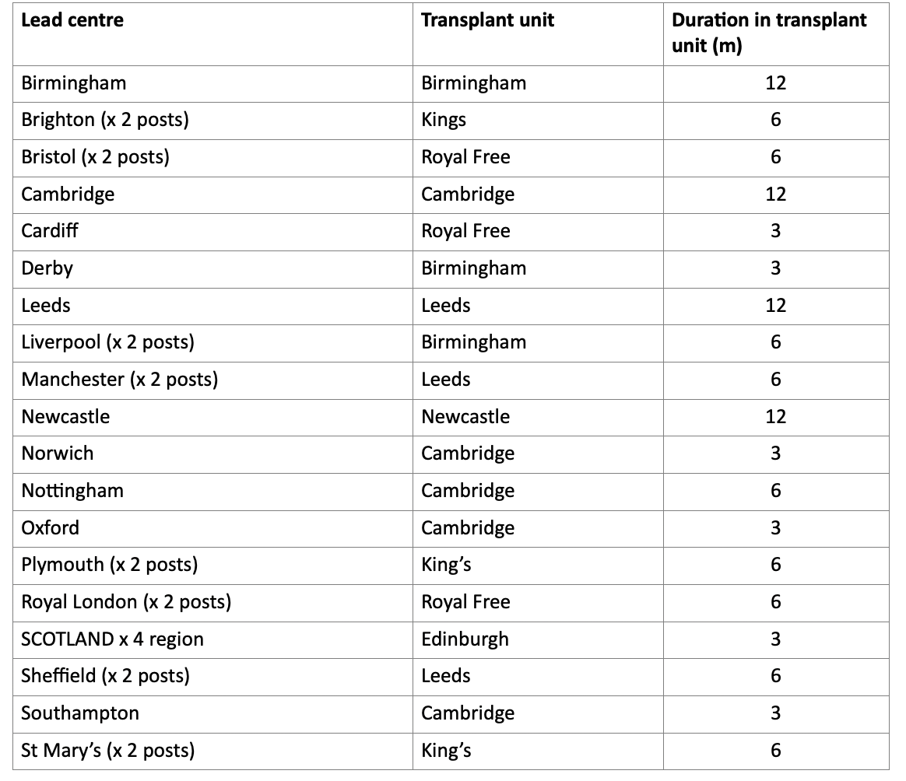
2025 posts
NB re ‘x2 posts’ these would be shared across the two sites according to funding arrangements which TPDs will be aware of – eg KSS fund both Brighton posts

